Slide 1

CMRTC ANDROID APPLICATION
CMR TECHNICAL CAMPUS Accredited by NBA, Approved by AICTE, affiliated to JNTUH Kandlakoya (v), Medchal Road, Hyderabad-501401
Under Guidance
B. Ramji
(Assistant Professor)
Team Members
Ankit Palahania (177R1A05K2)
K. Shravya (177R1A05L4)
Achyuth Reddy ( 177r1a05l5)

Slide 2
CONTENTS
Abstract
Existing System
Disadvantages
Proposed System
Advantages
Hardware and Software Requirements
Architecture
Modules
UML Diagrams
Conclusion

Slide 3
ABSTRACT
This app is an educational app which is made for our college students and faculty members and in this android app the admin add the Image, news, and quiz questions of different categories. These news, image, quiz questions are shown to user with its categories. Along with that in this, admin can add the study materials for students so that students can refer those for exam preparation. So, for study purpose it is very suitable for students and for news feed management and gallery management, quizzes and other information it is suitable for faculty members. Hence, this app is focused for the welfare of our college (i.e. CMR Technical Campus) students and faculty members as well.

Slide 4
EXISTING SYSTEM
In the existing system there are no good features and also news feed option , interface and study material management is not there. Students have to visit the complicated sites of colleges to get the college related information and the information available is not furnished and sometimes students have to pay for books and study materials. So, there are so many drawbacks in the existing system.

Slide 5
DISADVANTAGES
No proper app available for our college students.
There is no proper source from where students can get their material.
Existing systems have privacy and security related issues for users.
The user interface is not good and has very less functionality

Slide 6
PROPOSED SYSTEM
The proposed system consists of two android applications named as CMRTC and CMRTC ADMIN apps which is used for college news management, for college information, administration and gallery management and along with that it provides study material and books to the students at free cost. It has very seamless and interactive user interface and it overcomes all the shortcoming of the existing system. We have used simple but yet effective algorithms like Hashing, Language detection algorithm, Searching and Dijkstras algorithm.

Slide 7
ADVANTAGES
Provides study materials and books to students of our college at free of cost.
Materials and other information can shared to others as well.
Highly secure and privacy is maintained properly as we are using firebase database.
Interactive user interface and has seamless performance and can run on any android device (low end to high end device).
Efficient RAM and Power consumption.

Slide 8
HARDWARE REQUIREMENTS
For developing the application, the following are the Hardware Requirements:
PROCESSOR: minimum Intel i3 (5th gen).
SPACE ON HARD DISK: minimum 2GB space.
RAM: minimum 4GB

Slide 9
SOFTWARE REQUIREMENTS
Operating Systems supported:
Windows 7, 8 and 10
Other softwares required In the Development:
1. IDE: Android Studio
2. Adobe XD (For Icon Designing)
3. LANGUAGES: JAVA and XML
4. DATABSE: Firebase

Slide 10

Architecture
Upload Notice
Update Gallery
Update Study Material
Update Faculty
Delete Notice
Logout
Login
Stores all data
ADMIN
Logout
Student can share feedback
About College
Location in Google Maps
Notice Board
Gallery (Events, Library, Placements)
Faculty
Study Material (EBooks, Papers, Solutions)
Video Lectures
College website
Share the App
Change Theme
STUDENT
Student accessing
the data

Slide 11
Modules
ADMIN (Faculty)
STUDENT

Slide 12
UML DIAGRAMS
Use Case Diagram
Class Diagram
Sequence Diagram
Activity Diagram

Slide 13
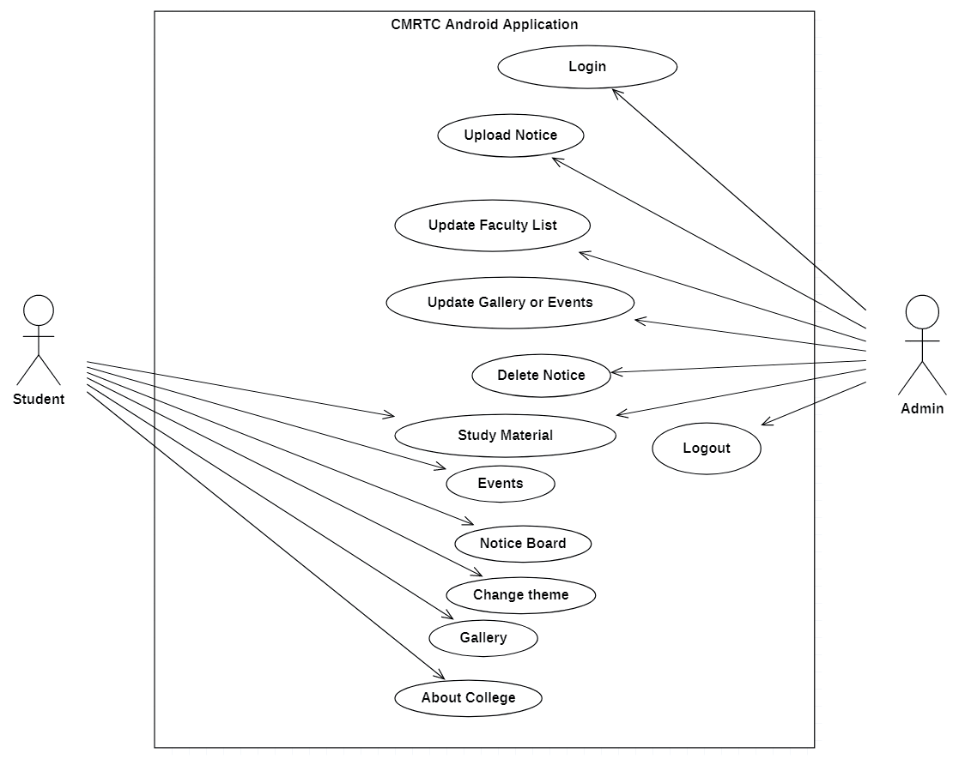
USE CASE DIAGRAM

Slide 14
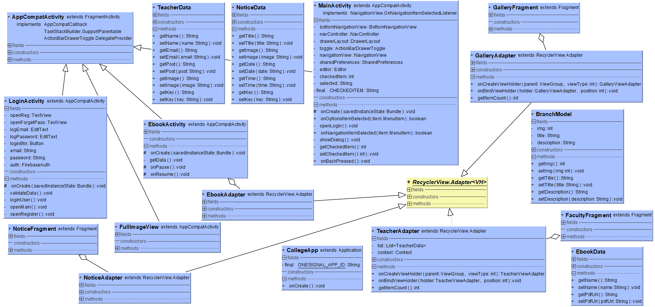
CLASS DIAGRAM

Slide 15
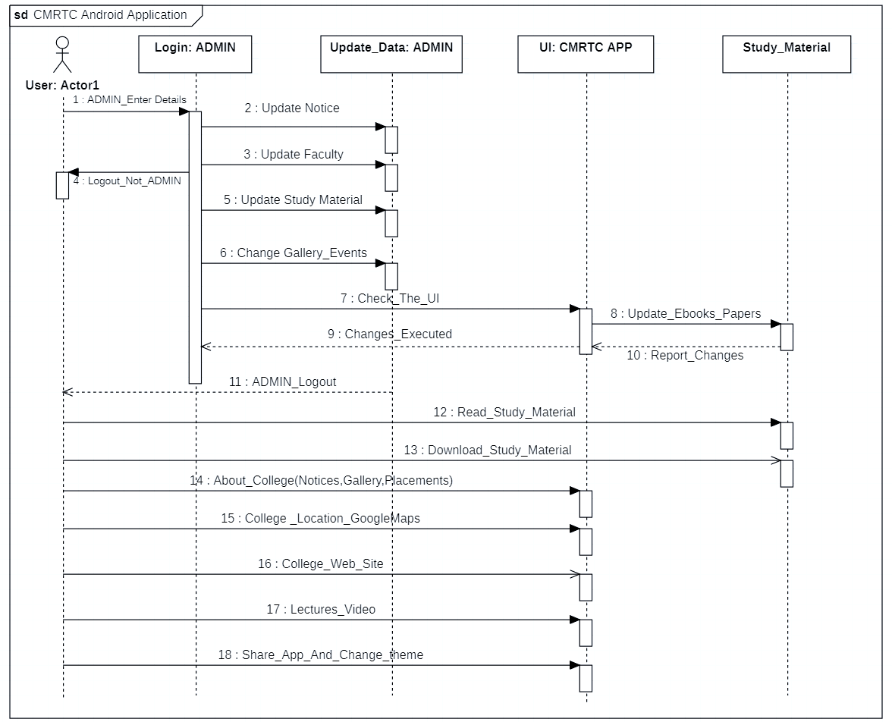
Sequence Diagram

Slide 16
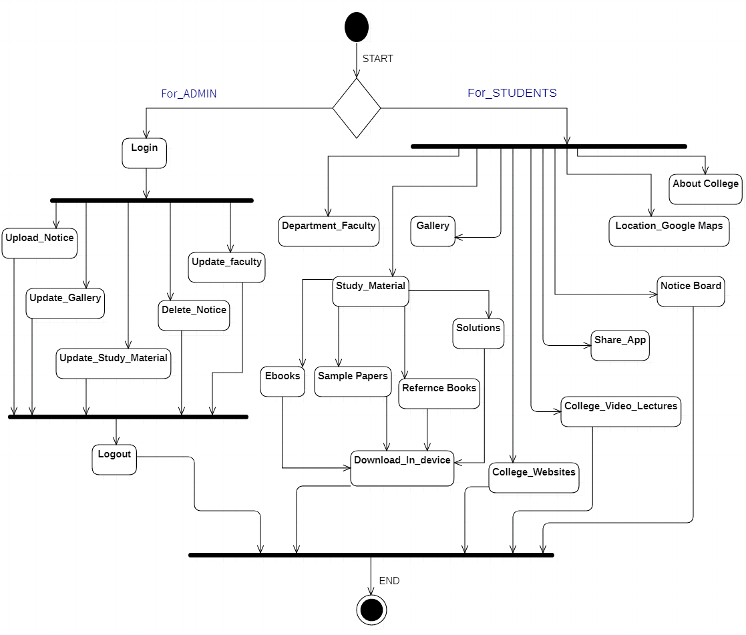
Activity Diagram

Slide 17
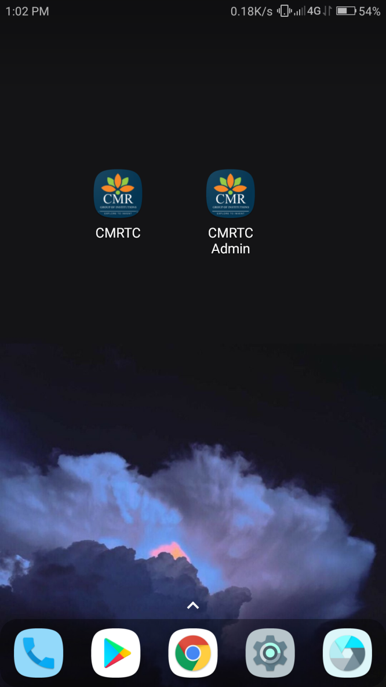
Screenshots
CMRTC app icon
CMRTC Admin app ICONS

Slide 18
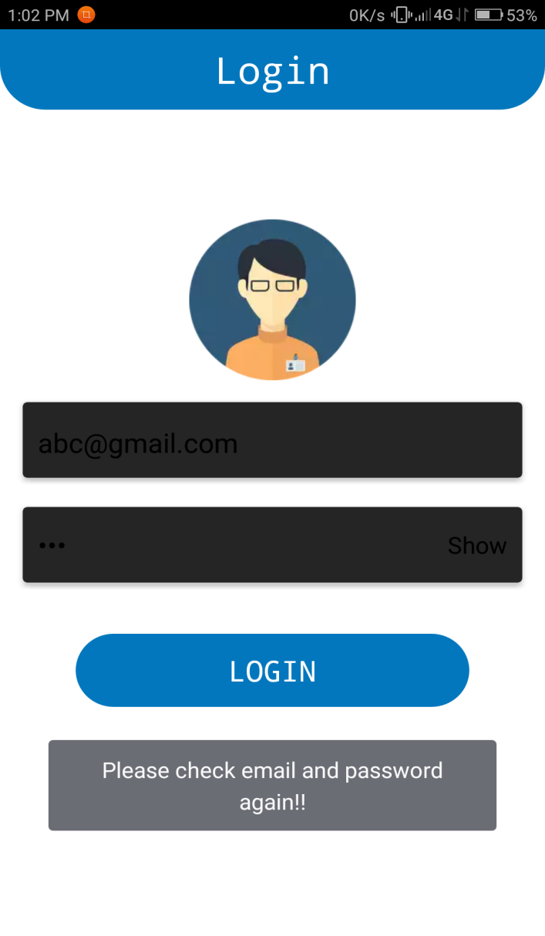
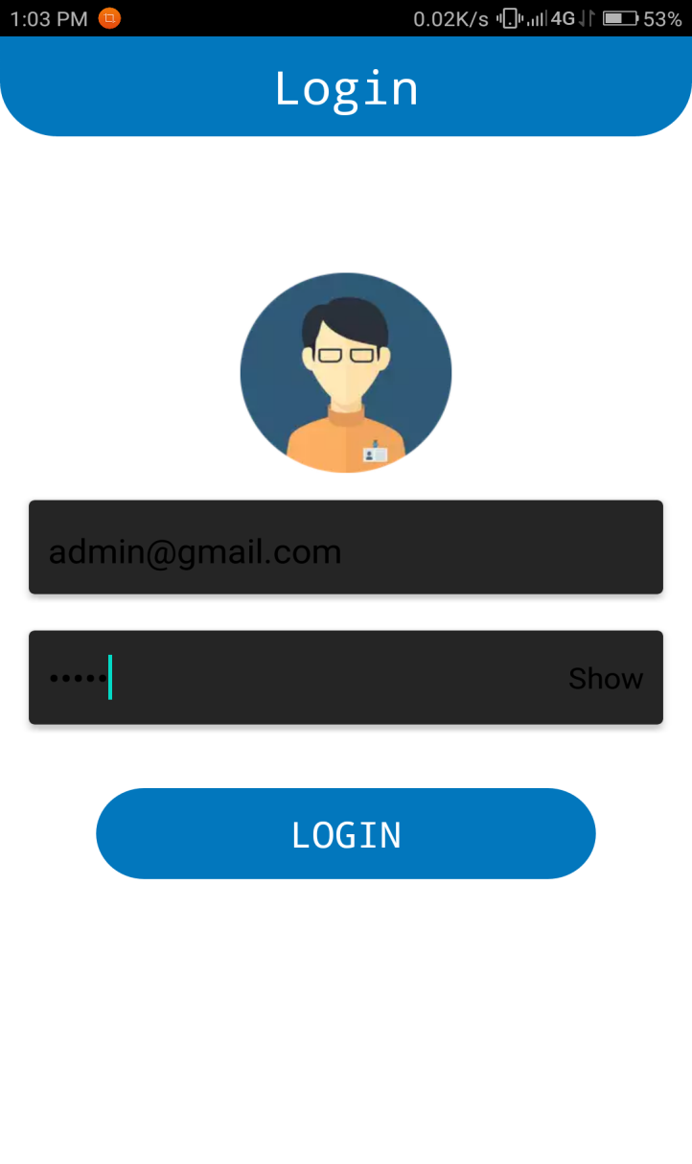
Cmrtc Admin app

Slide 19
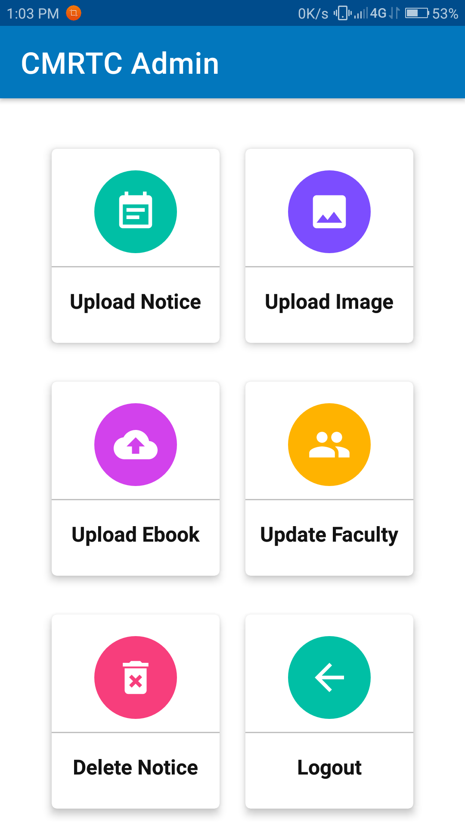
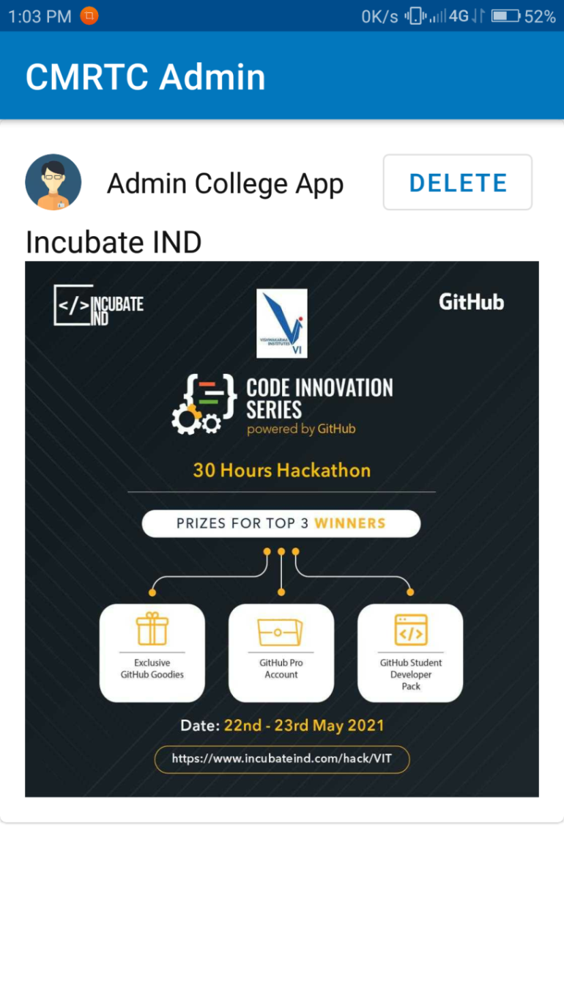
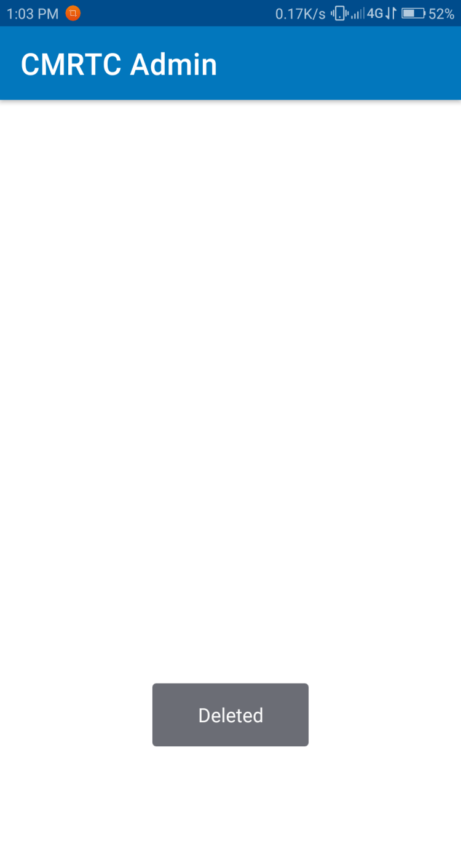

Slide 20
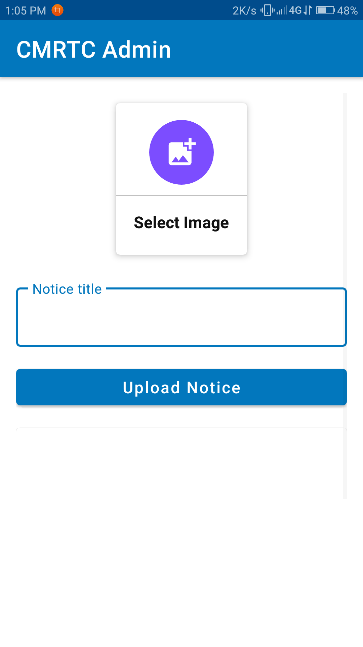
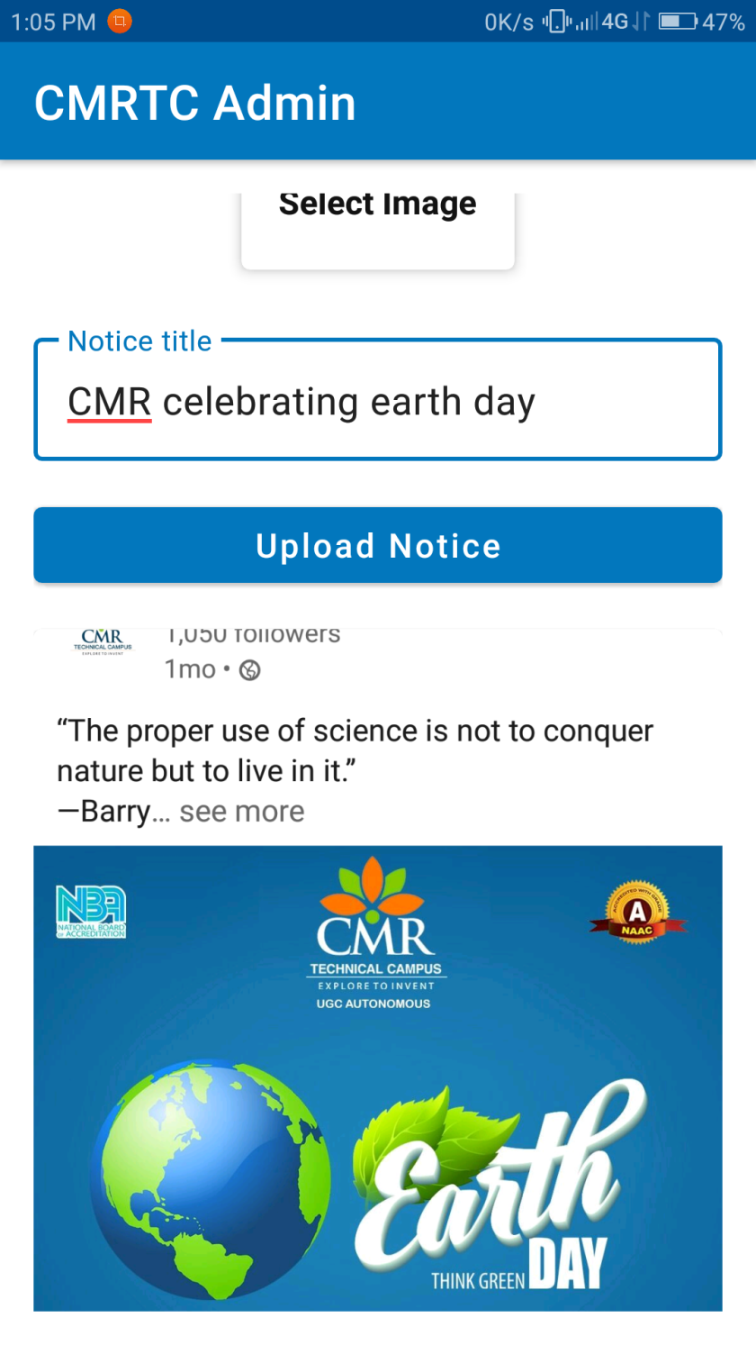
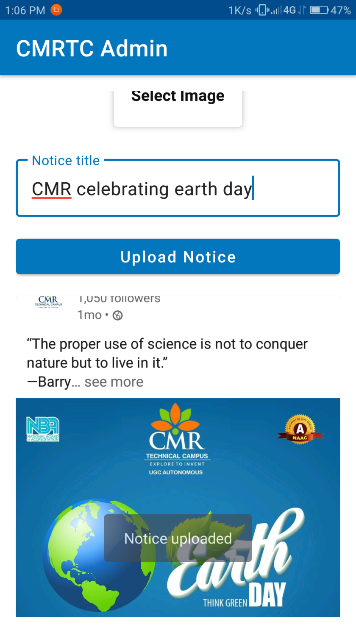

Slide 21
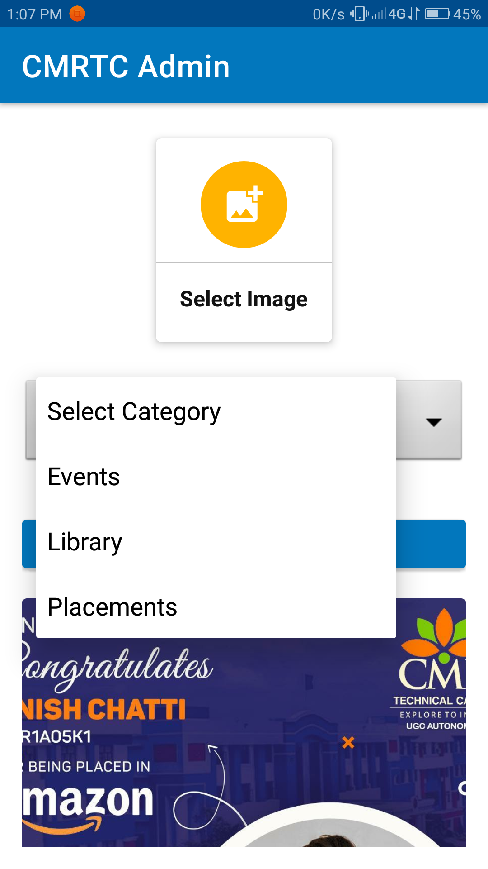
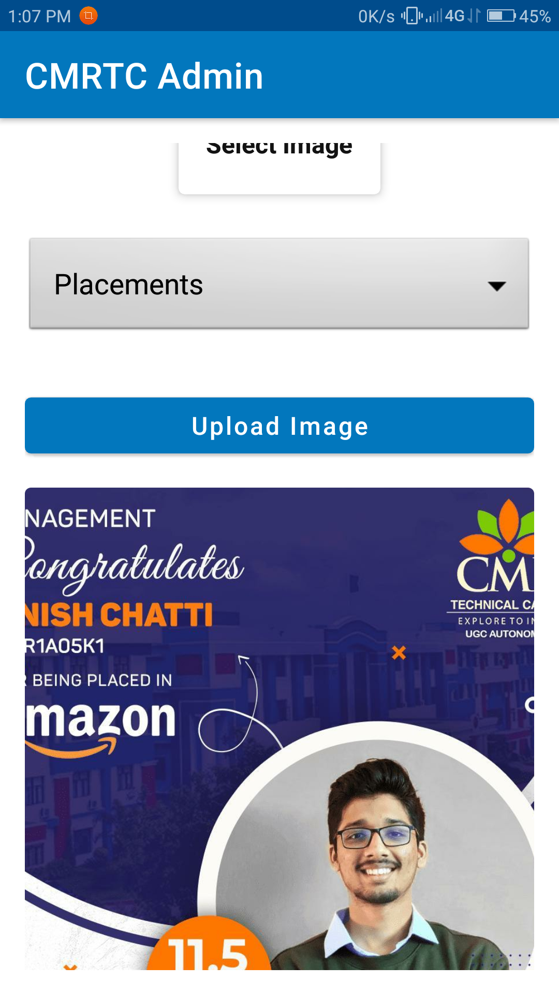

Slide 22
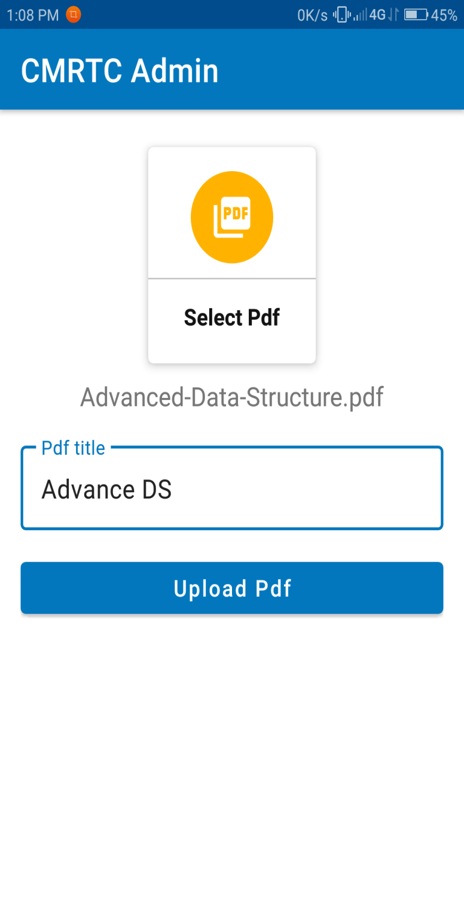
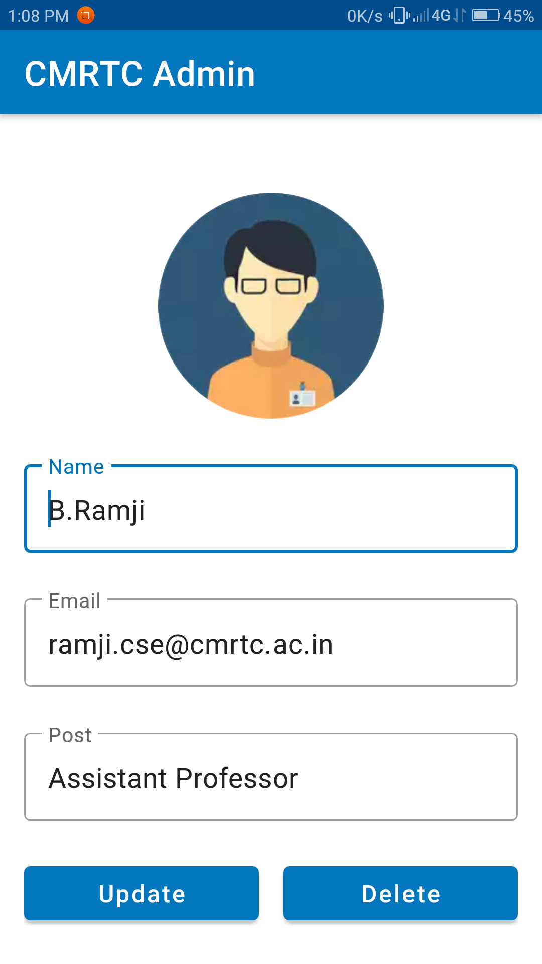
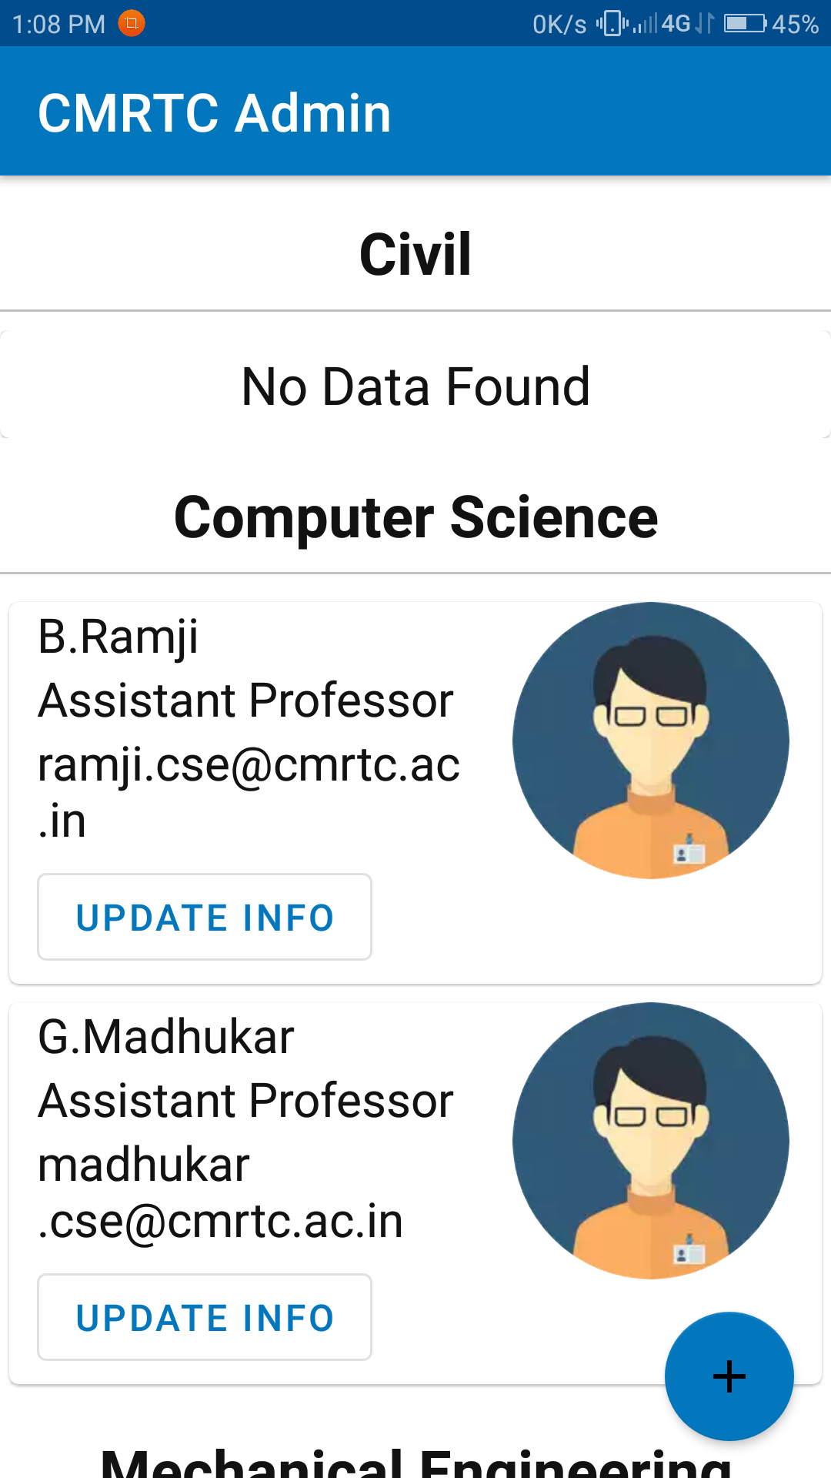

Slide 23
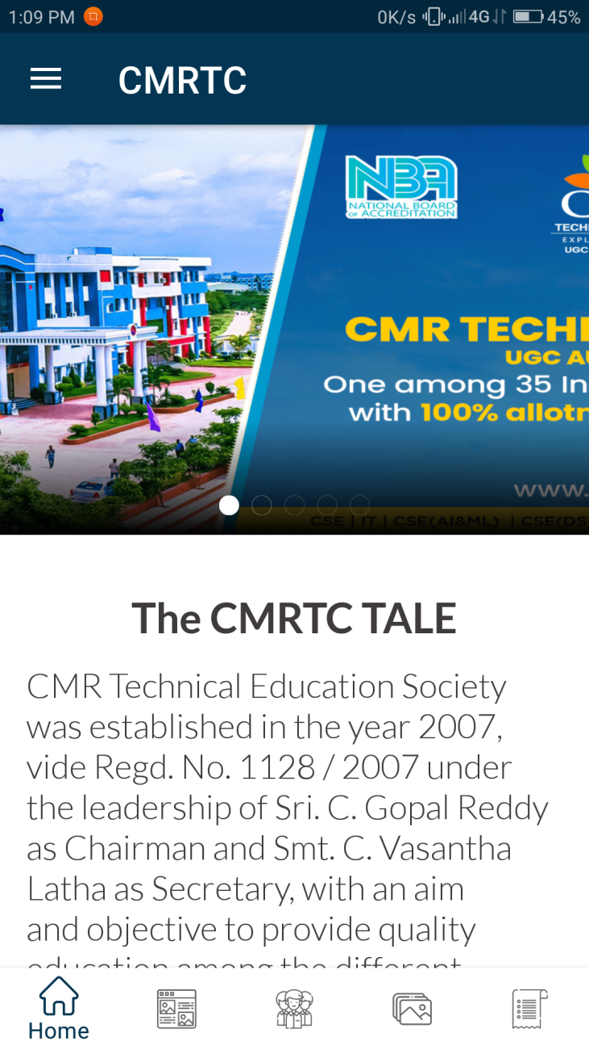
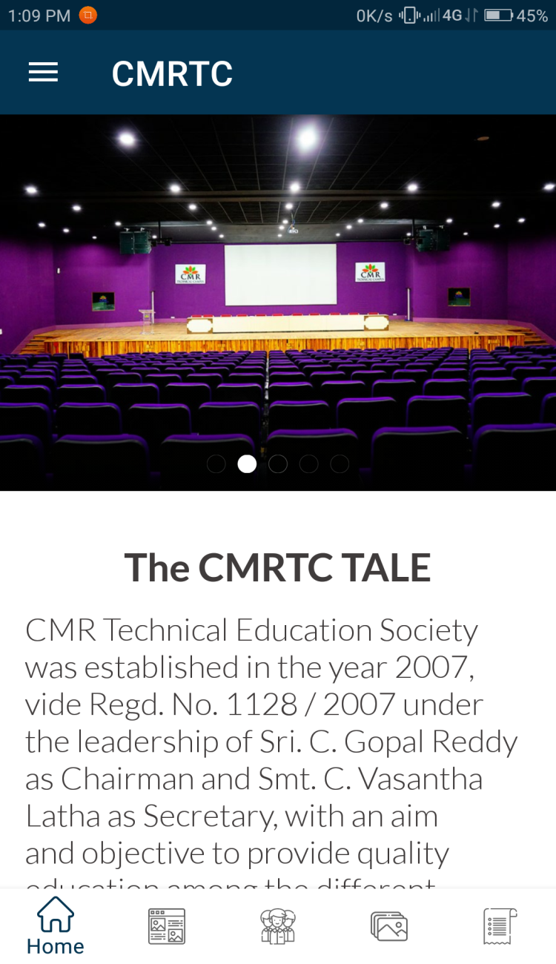
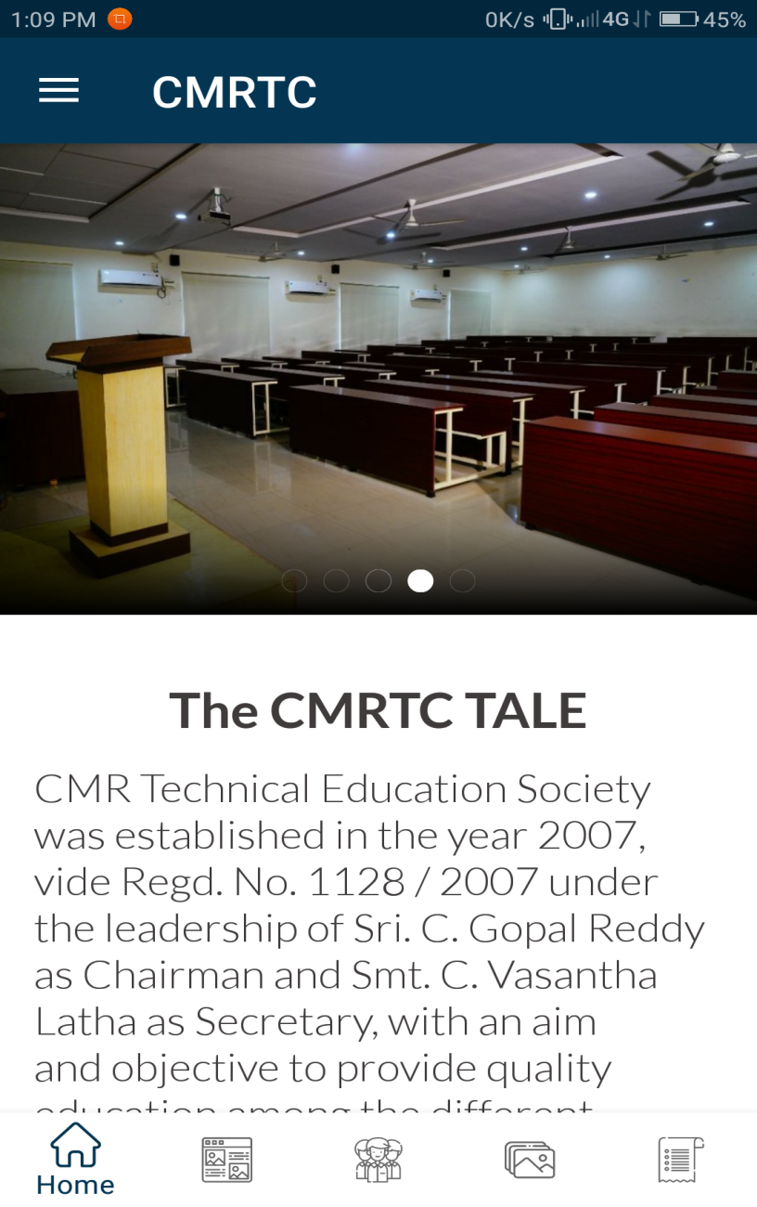
CMRTC APP

Slide 24
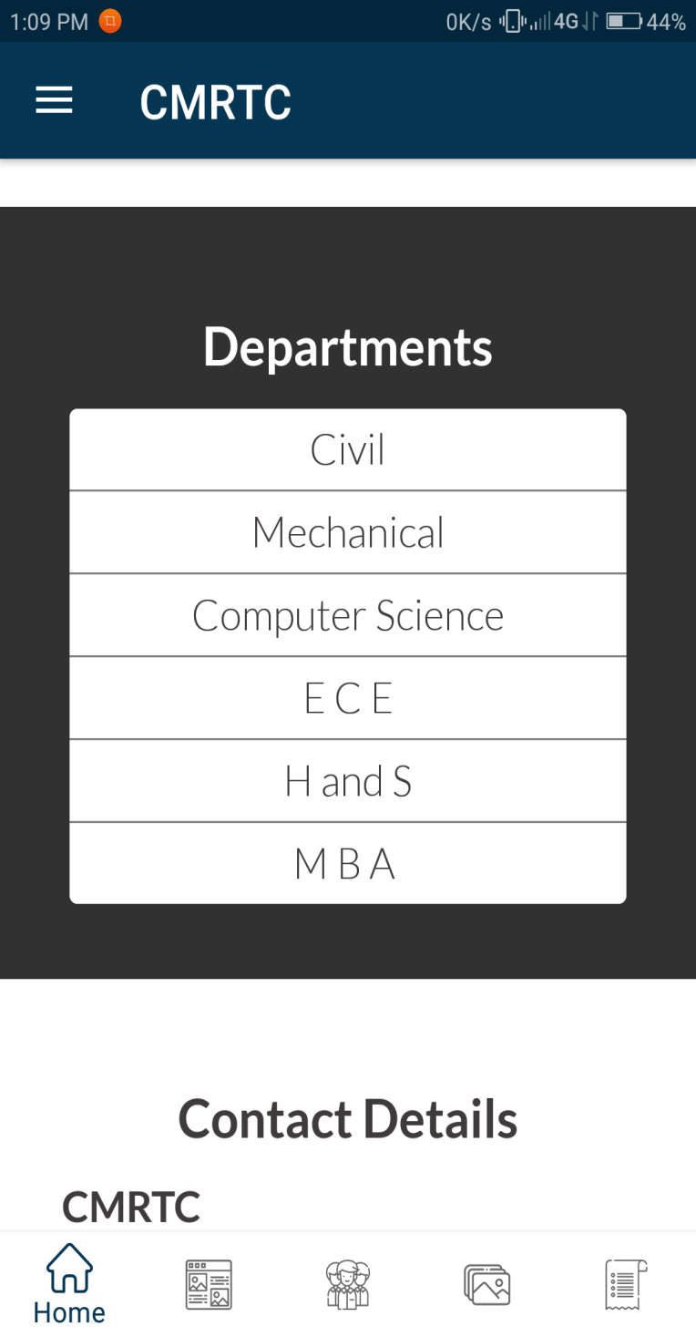
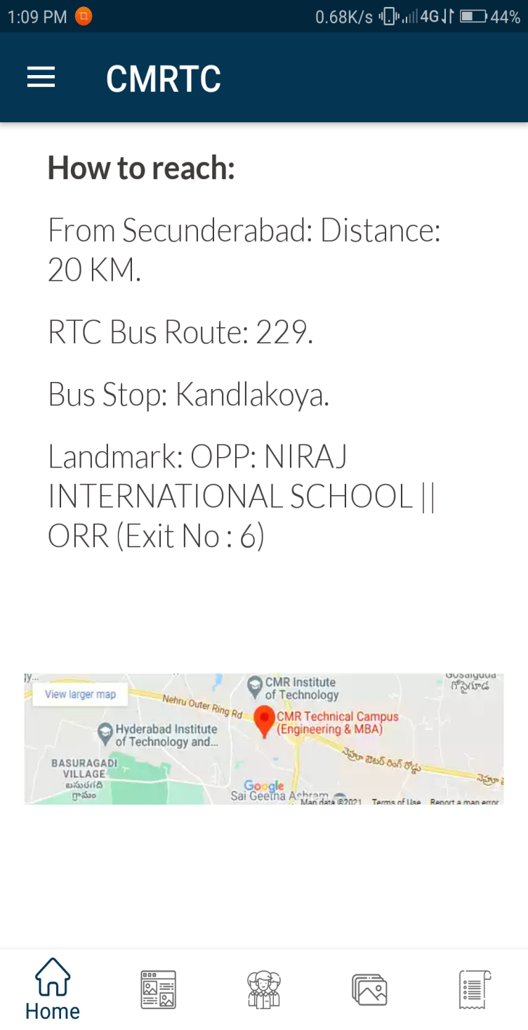
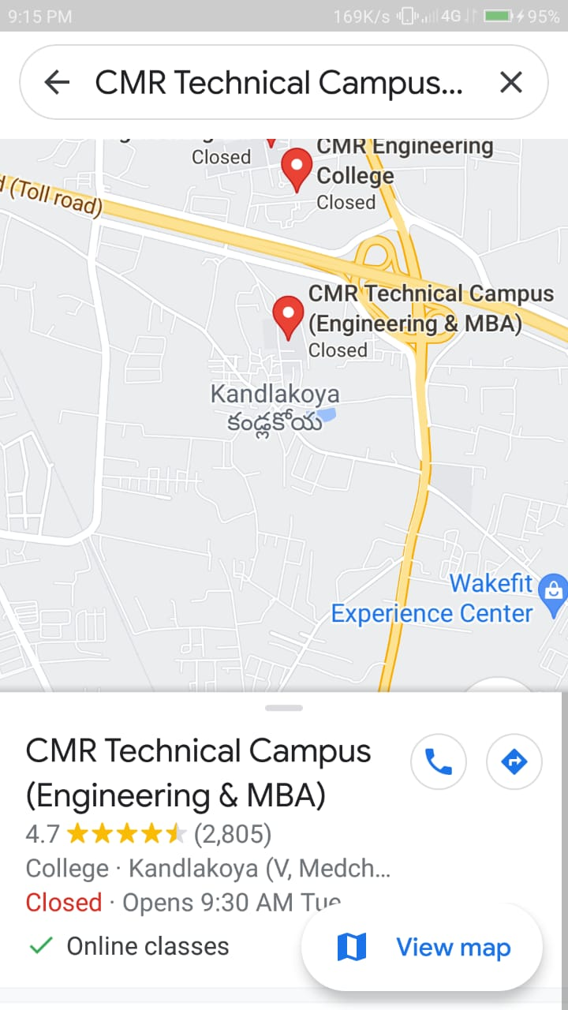

Slide 25
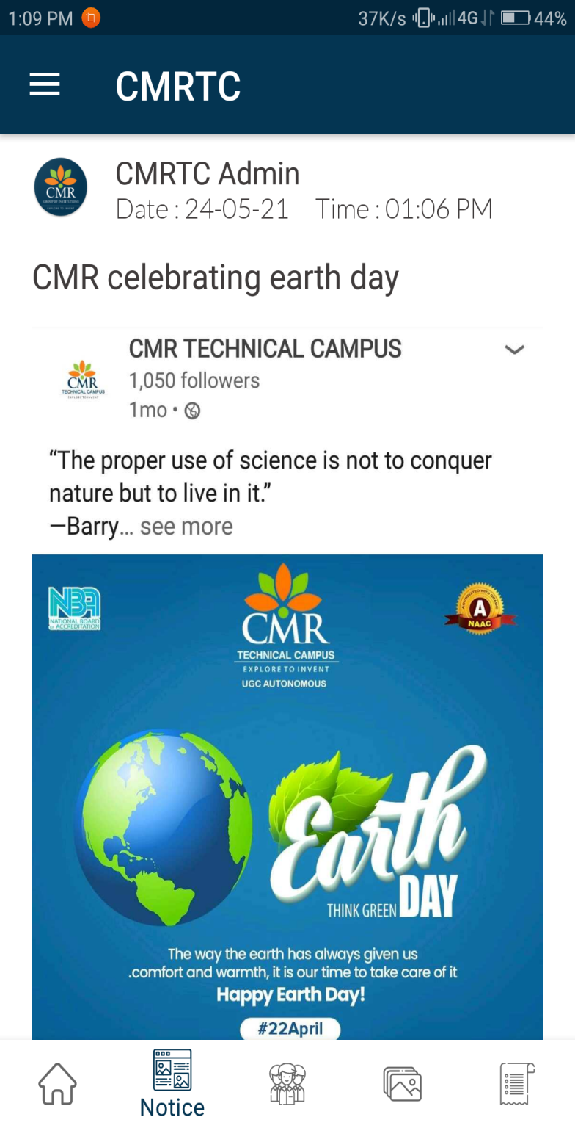
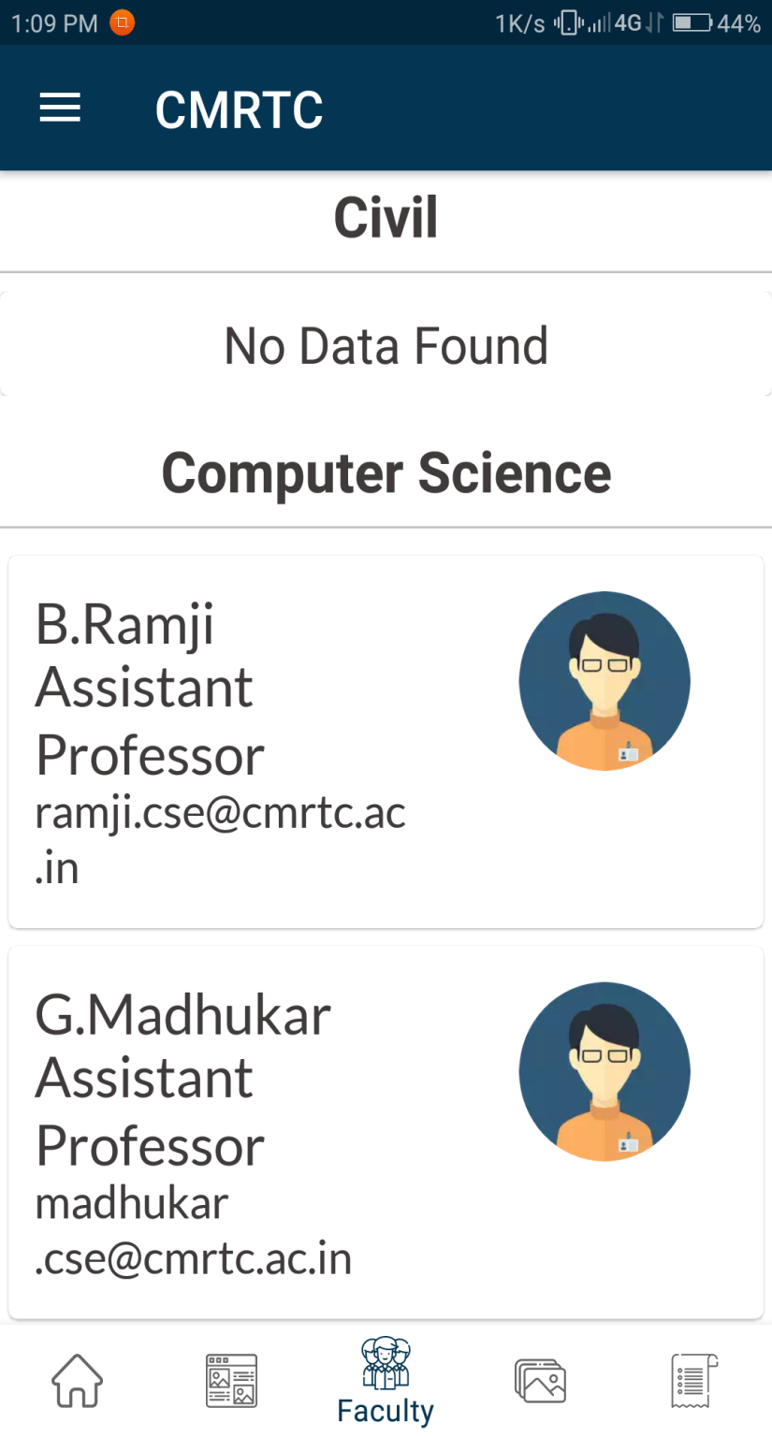
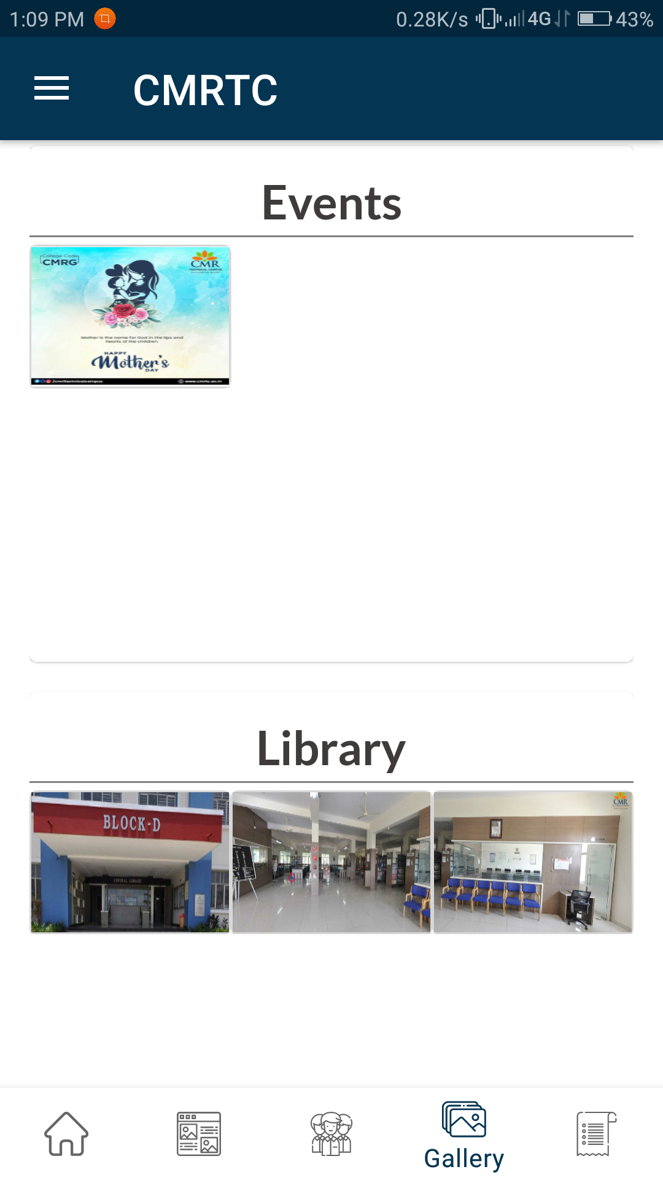

Slide 26
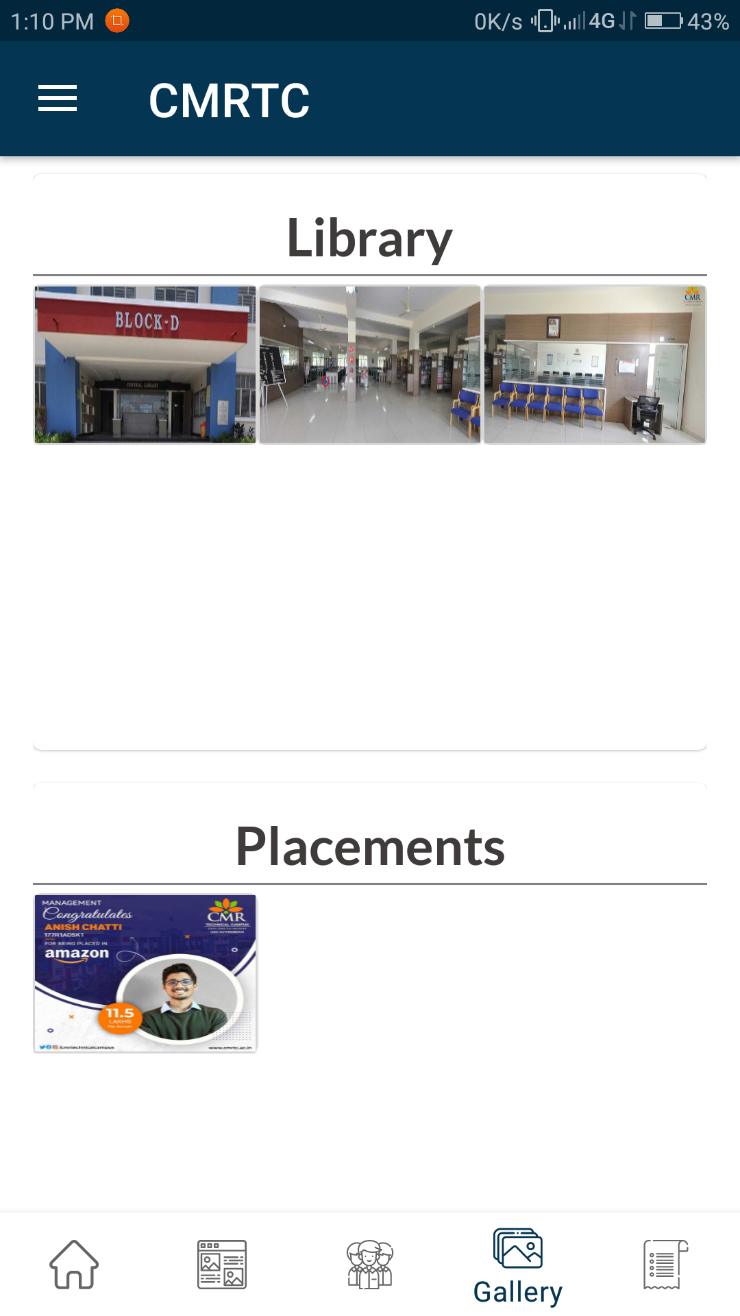
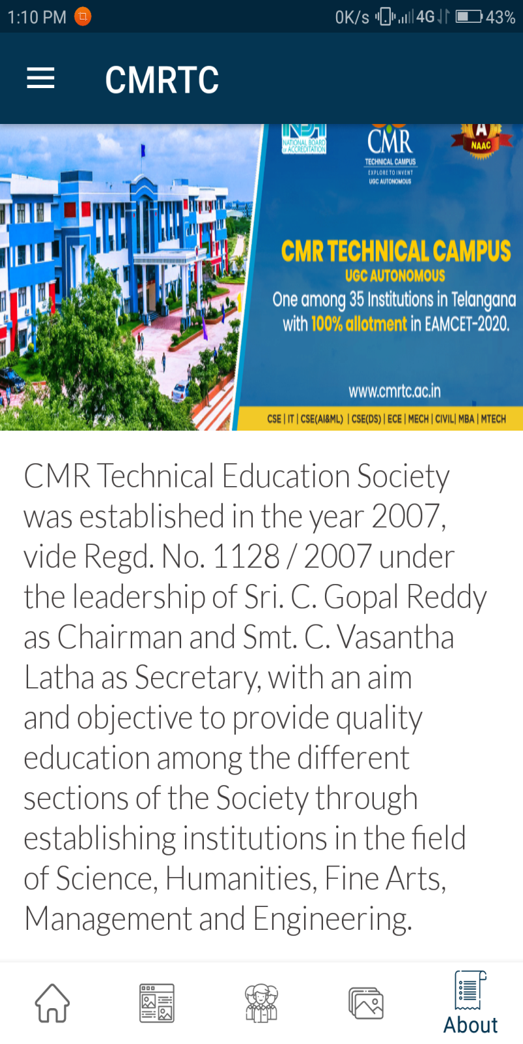
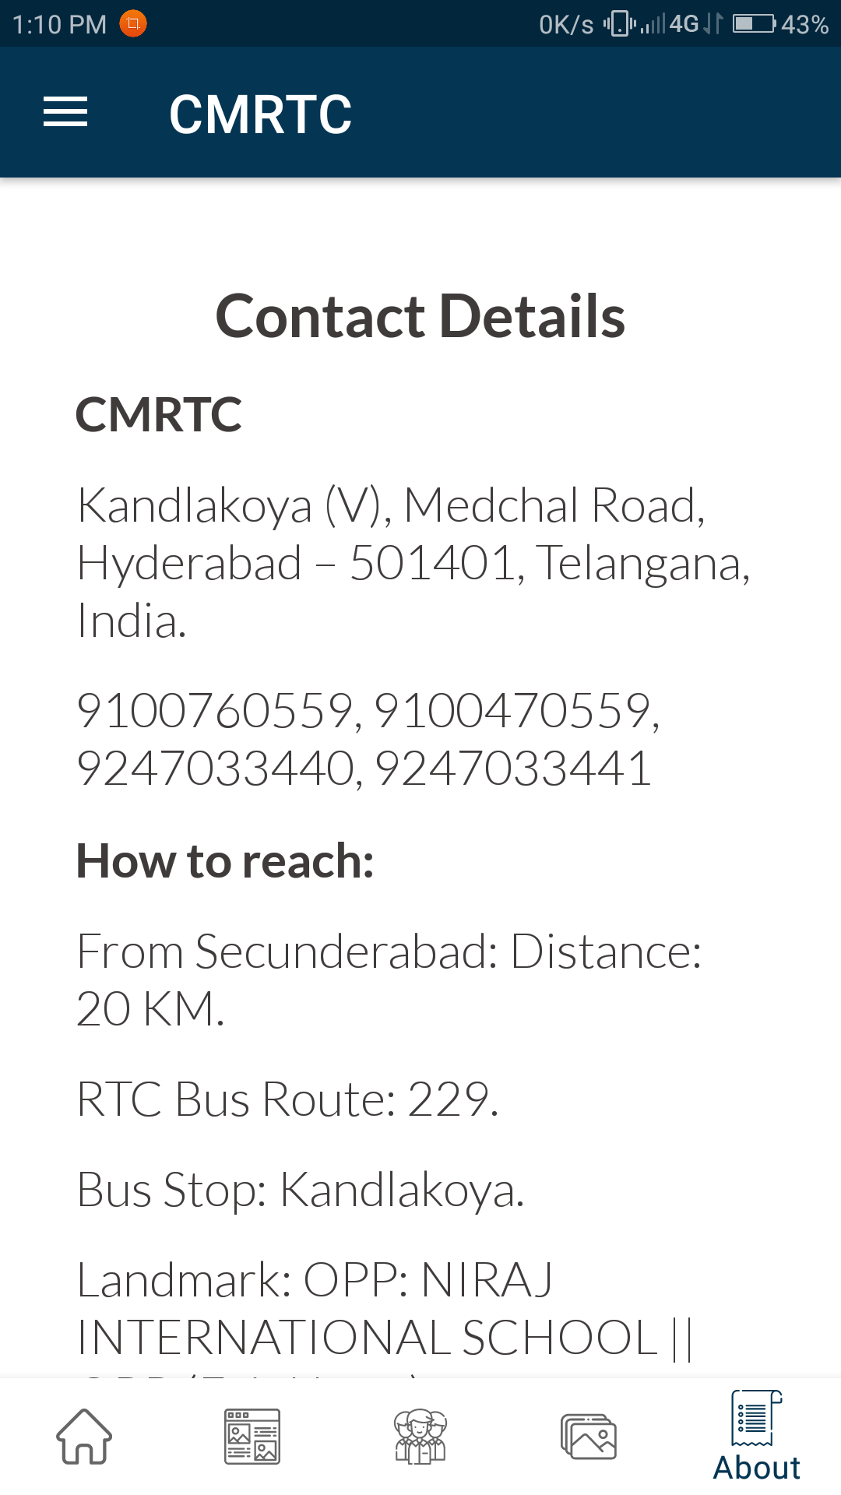

Slide 27
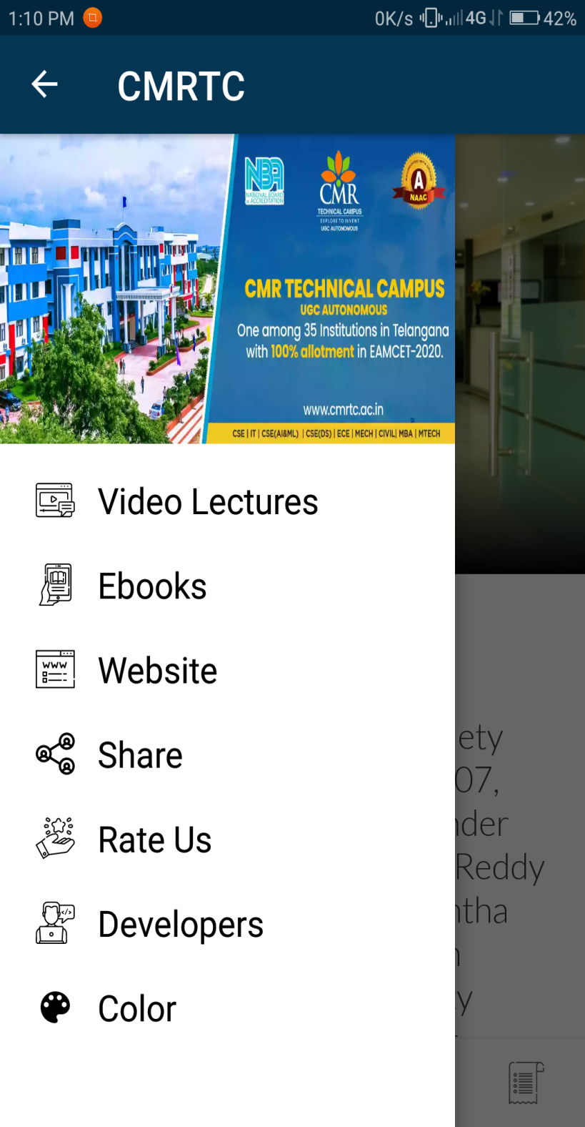
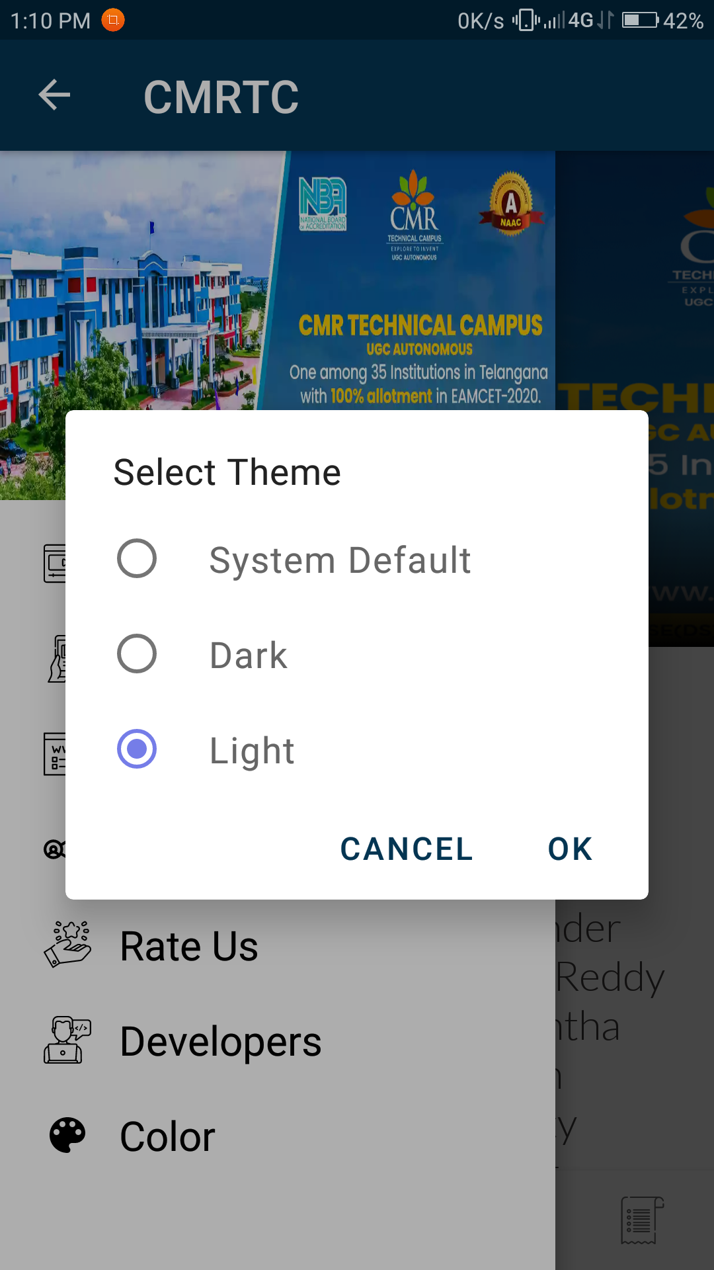
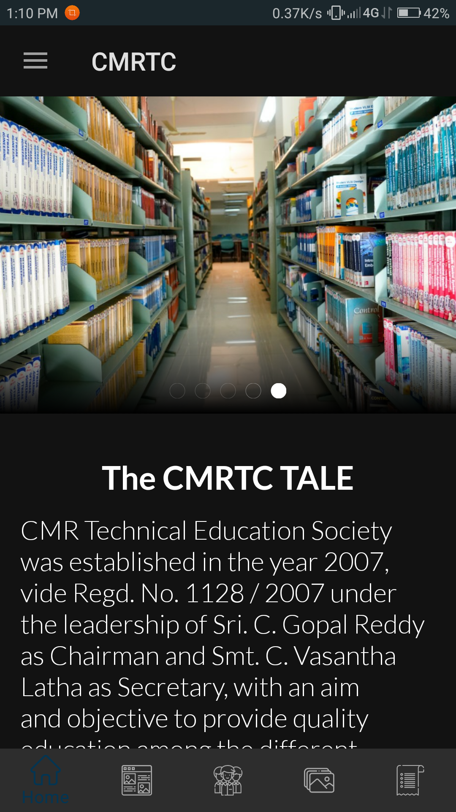

Slide 28

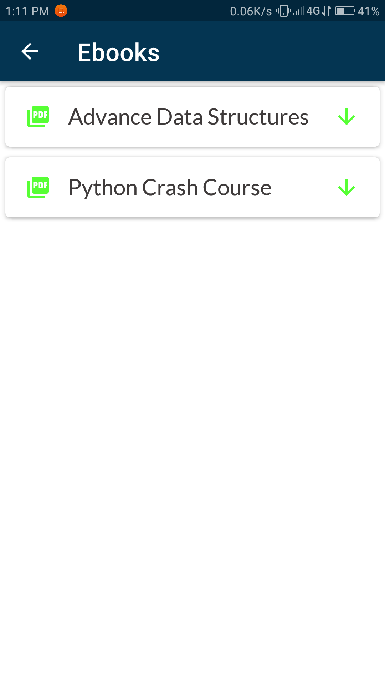
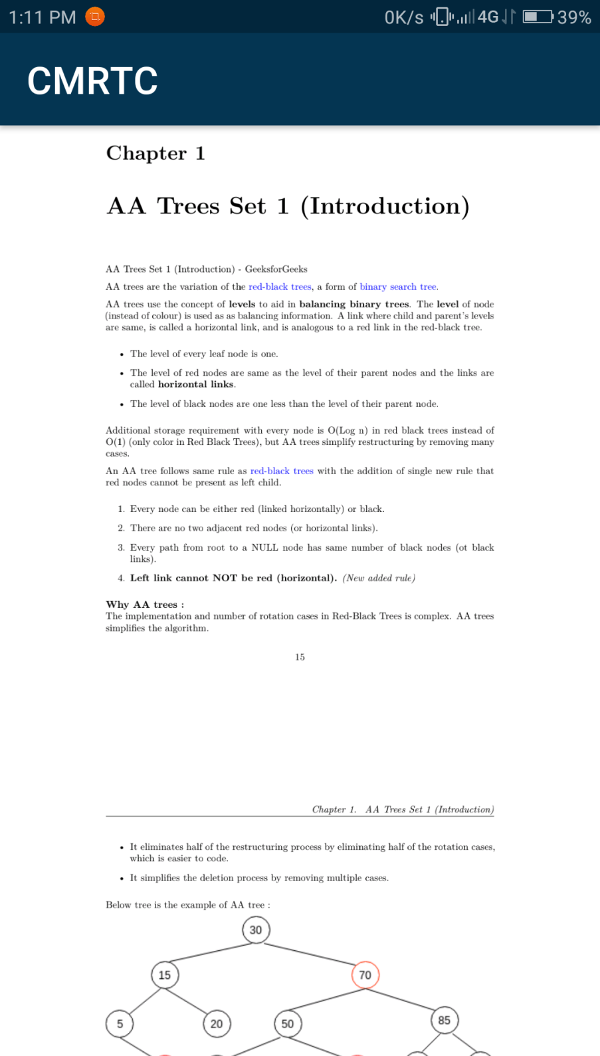

Slide 29
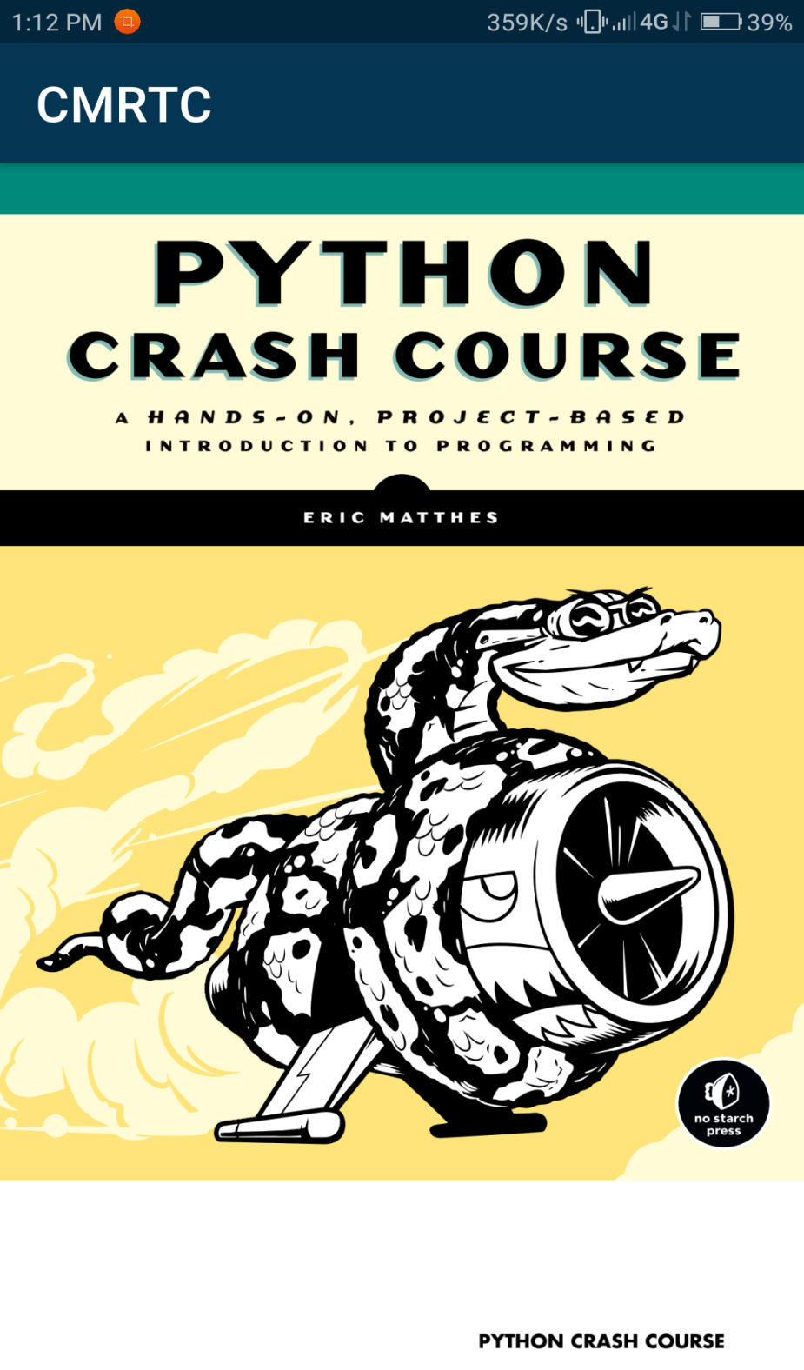
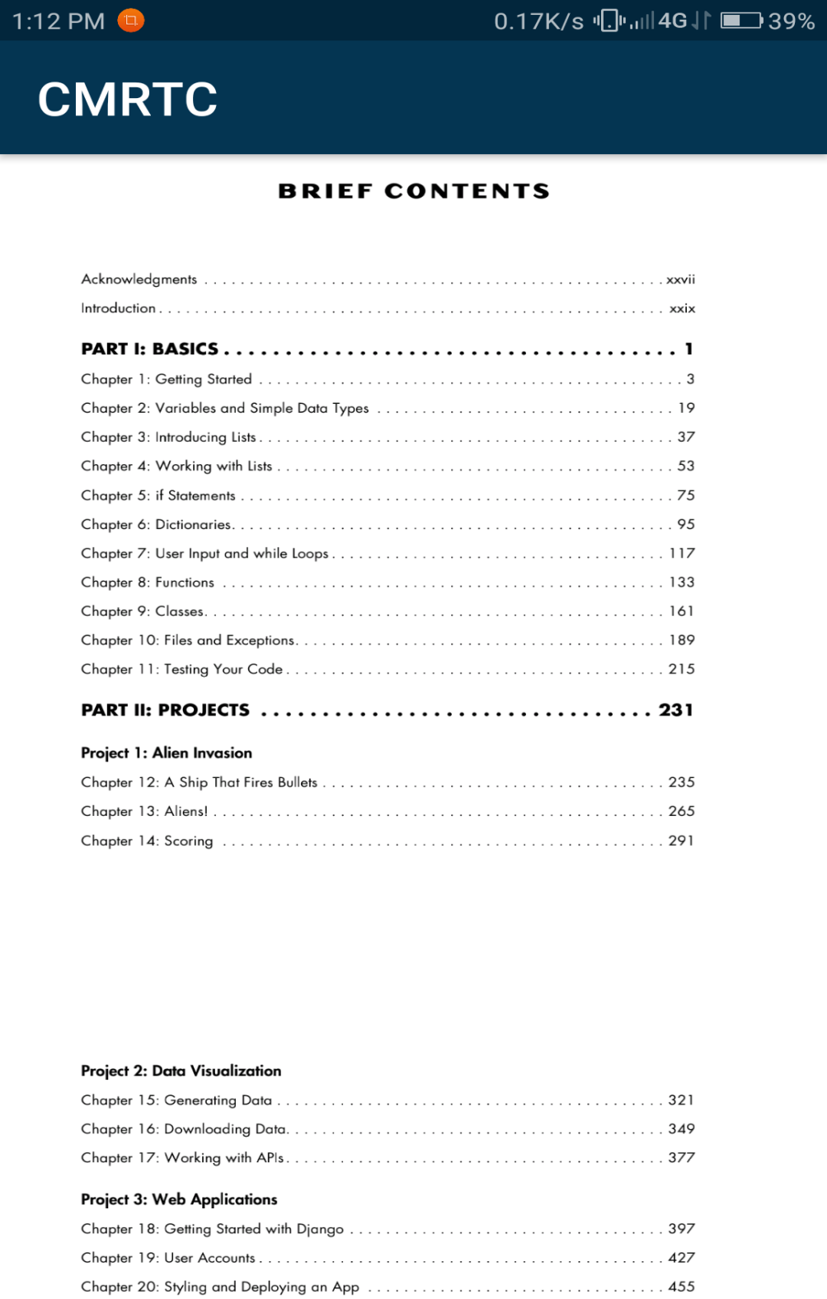

Slide 30
EXECUTION

Slide 31
MainActivity.java
package cmrtc.ac.in;
import android.content.ActivityNotFoundException;
import android.content.Context;
import android.content.DialogInterface;
import android.content.Intent;
import android.content.SharedPreferences;
import android.net.Uri;
import android.os.Bundle;
import android.widget.Toast;
import com.google.android.material.bottomnavigation.BottomNavigationView;
import com.google.android.material.dialog.MaterialAlertDialogBuilder;
import androidx.core.view.GravityCompat;
import androidx.drawerlayout.widget.DrawerLayout;
import androidx.navigation.NavController;
import androidx.navigation.Navigation;
import androidx.navigation.ui.NavigationUI;
import cmrtc.ac.in.authentication.LoginActivity;
import cmrtc.ac.in.ebook.EbookActivity;
import static androidx.appcompat.app.AppCompatDelegate.MODE_NIGHT_FOLLOW_SYSTEM;

Slide 32
public class MainActivity extends AppCompatActivity implements NavigationView.OnNavigationItemSelectedListener {
private BottomNavigationView bottomNavigationView;
private NavController navController;
private DrawerLayout drawerLayout;
private SharedPreferences.Editor editor;
private int checkedItem;
private String selected;
private final String CHECKEDITEM = "checked_item";
@Override
protected void onCreate(Bundle savedInstanceState) {
super.onCreate(savedInstanceState);
setContentView(R.layout.activity_main);
FirebaseMessaging.getInstance().subscribeToTopic("notification");
sharedPreferences = this.getSharedPreferences("themes", Context.MODE_PRIVATE);
editor = sharedPreferences.edit();
switch (getCheckedItem()) {
case 0:
AppCompatDelegate.setDefaultNightMode(MODE_NIGHT_FOLLOW_SYSTEM);
break;
case 1:
AppCompatDelegate.setDefaultNightMode(AppCompatDelegate.MODE_NIGHT_YES);
break;
case 2:
AppCompatDelegate.setDefaultNightMode(AppCompatDelegate.MODE_NIGHT_NO);
break; }

Slide 33
bottomNavigationView = findViewById(R.id.bottomNavigationView);
navController = Navigation.findNavController(this, R.id.frame_layout);
drawerLayout = findViewById(R.id.drawerLayout);
navigationView = findViewById(R.id.navigation_view);
toggle = new ActionBarDrawerToggle(this, drawerLayout, R.string.start, R.string.close);
drawerLayout.addDrawerListener(toggle);
toggle.syncState();
Objects.requireNonNull(getSupportActionBar()).setDisplayHomeAsUpEnabled(true);
navigationView.setNavigationItemSelectedListener(this);
NavigationUI.setupWithNavController(bottomNavigationView, navController);
}
@Override
public boolean onOptionsItemSelected(@NonNull MenuItem item) {
toggle.onOptionsItemSelected(item);
// if (item.getItemId() == R.id.logout) {
// auth.signOut();
// openLogin();
// }
return true;
}
private void openLogin() {
startActivity(new Intent(MainActivity.this, LoginActivity.class));
finish();
}

Slide 34
@Override
public boolean onNavigationItemSelected(@NonNull MenuItem item) {
Uri uri;
Context context = getApplicationContext();
switch (item.getItemId()) {
case R.id.navigation_developer:
startActivity(new Intent(MainActivity.this, DeveloperActivity.class));
break;
case R.id.navigation_video:
uri = Uri.parse("https://cmrtc.ac.in/infrastructure/library/");
startActivity(new Intent(Intent.ACTION_VIEW,uri));
break;
case R.id.navigation_rate:
uri = Uri.parse("https://cmrtc.ac.in/administration/about-society/");
startActivity(new Intent(Intent.ACTION_VIEW,uri));
break;
case R.id.navigation_ebook:
startActivity(new Intent(this, EbookActivity.class));
break;
case R.id.navigation_website:
uri = Uri.parse("https://cmrtc.ac.in/");
startActivity(new Intent(Intent.ACTION_VIEW, uri));
break;

Slide 35
case R.id.navigation_share:
try{
Intent i = new Intent(Intent.ACTION_SEND);
i.setType("text/plain");
i.putExtra(Intent.EXTRA_SUBJECT, " ");
i.putExtra(Intent.EXTRA_TEXT, "https://play.google.com/store/apps/details?id="+context.getPackageName());
startActivity(Intent.createChooser(i, "Share with "));
}catch (Exception e){
Toast.makeText(this, "Hmm.. Sorry, \nCannot be share", Toast.LENGTH_SHORT).show();
}
return true;
}
private void showDialog() {
final String[] themes = this.getResources().getStringArray(R.array.theme);
MaterialAlertDialogBuilder builder = new MaterialAlertDialogBuilder(this);
builder.setTitle("Select Theme");
builder.setSingleChoiceItems(R.array.theme, getCheckedItem(), new DialogInterface.OnClickListener() {
@Override
public void onClick(DialogInterface dialogInterface, int i) {
selected = themes[i];
checkedItem = i;
}
});

Slide 36
private int getCheckedItem() {
return sharedPreferences.getInt(CHECKEDITEM, 0);
}
private void setCheckedItem(int i) {
editor.putInt(CHECKEDITEM, i);
editor.apply();
}
@Override
public void onBackPressed() {
if (drawerLayout.isDrawerOpen(GravityCompat.START)) {
drawerLayout.closeDrawer(GravityCompat.START);
} else
super.onBackPressed();
}
}

Slide 37
CONCLUSION
We have developed this project specifically for the college students and the faculty of our college. Our app provides easy access of information, better user interaction, convenient interface, features and study material accessibility which gives our app an upper edge over the old college website. We have made sure that the privacy is maintained properly and only authorized faculty will be allowed to use the CMRTC admin application.

Slide 38
THANK YOU

